Slide 1
Hashing and hash tables
SESSION 13-14
Henry Lucky, S.Kom., M.Kom.

Slide 2
LEARNING OUTCOMES
At the end of this session, students will be able to:
LO 1: Explain the concept of data structures and its usage in Computer Science
LO 2: Illustrate any learned data structure and its usage in application
LO 3: Apply data structures using C

Slide 3
SUBTOPICS
Maps
Hash table
Hashing
Hash Function
Collision
Program Example using Array
Program Example using Linked List

Slide 4
maps
Concept
Maps (also known as Dictionaries) are data structures stores a collection of key-value pairs.
Each key is unique and allows for quick access to values.
A real life example of a map could be storing the grades for students in a class (student name is key, grade is value).

Slide 5
Hash tables
Concept
Hash Table is a data structure which organizes data using hash functions in order to support quick insertion and search.
There are two different kinds of hash tables: hash set and hash map.
The hash set is one of the implementations of a set data structure to store no repeated values.
The hash map is one of the implementations of a map data structure to store (key, value) pairs. Here, the key is index, while the value is the key of each data.
In this session, whenever we mention hash table, we refer to hash map.

Slide 6
Hash tables
Hashing
In hash table, the indices is extracted from the key of the data using a hash function.
For example, we will use a hash function that extracts the first character of a key string value and map it into some numbers.
Therefore, we map the key to array indices.
This process of mapping the key to appropriate indices in a hash table is called hashing.

Slide 7
Hash tables
Hashing
Consider this example:
Supposed we want to store 5 key string: define, float, exp, char, atan into a hash table with size 26.
The hash function we will use is “transform the first character of each string into a number between 0..25”
(a will be 0, b will be 1, c will be 2, …, z will be 25).

Slide 8
Hash tables
Hashing
This is the hash table of those string.
atan is stored in h[0] because a is 0.
char is stored in h[2] because c is 2.
define is stored in h[3] because d is 3.
and so on..
We only consider the first character of each string.

Slide 9
Hash function
functions
There are many ways to map a key into an index. The following are some of the important methods for constructing hash functions.
Mid-square
Division (most common)
Folding
Digit Extraction
Rotating Hash

Slide 10

Hash function
Mid-square
Square the key and then use an appropriate number of bits from the middle of the square to obtain the index (hash-key).
If the key is a string, it is converted to a number.
Steps:
Square the key. (k²)
Extract the middle r bits of the result obtained in Step 1

Slide 11
Hash function
Mid-square
Here the entire key participates in generating the index so that there is a better chance that different index are generated even for keys close to each other.
For example,
Key Squared key Middle part
3121 9740641 406
3122 9746884 468
3123 9753129 531

Slide 12
Hash function
Mid-square
In practice it is more efficient to choose a power of 2 for the size of the table and extract the middle part of the bit representation of the square of a key.
If the table size is chosen in this example as 1024, the binary representation of square of 3121 is 1001010-0101000010-1100001.
The middle part can be easily extracted using a mask and a shift operation.

Slide 13
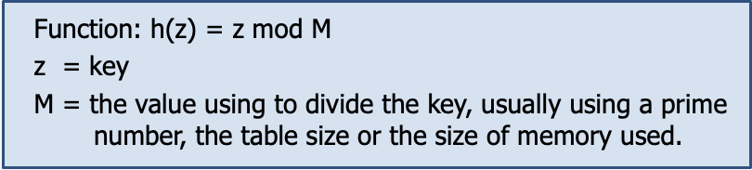
Hash function
division
Divide the key by using modulus operator.
The simplest method of hashing an integer.

Slide 14
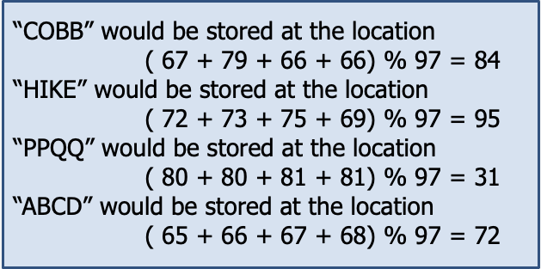
Hash function
division
Suppose the table is to store strings. A very simple hash function would be to add up ASCII values of all the characters in the string and take modulo of table size, say 97.

Slide 15
Hash function
FOLDING
Partition the key into several parts, then add the parts together to obtain the hash key.
Steps:
Divide the key into a number of parts
Add the individual part (usually the last carry is ignored)

Slide 16
Hash function
FOLDING
Given a hash table of 100 locations, calculate the hash value of 5678, 321 and 34567, since there are 100 locations to address, so we will break the key into parts where each part will contain two digits.
Key | 5678 | 321 | 34567
Parts | 56 and 78 | 32 and 1 | 34, 56 and 7
Sum | 134 | 33 | 97
Hash-key (index) | 34 (ignore the last carry) | 33 | 97

Slide 17
Hash function
Digit extraction
A predefined digit of the given number is considered as the hash address.
Example:
Consider x = 14,568
If we extract the 1st, 3rd, and 5th digit, we will get a hash code of : 158.

Slide 18
Hash function
Rotating hash
Use any hash method (such as division or mid-square method)
After getting the hash code/address from the hash method, do rotation
Rotation is performed by shifting the digits to get a new hash address.
Example:
Given hash address = 20021
Rotation result: 12002 (fold the digits)

Slide 19
collision
Concept
What will happen if we want to store these strings using the previous hash function (use the first character of each string)?
define, float, exp, char, atan, ceil, acos, floor.
There are several strings which have the same hash-key, it’s float and floor (hash-key: 5), char and ceil (hash-key: 2).
It’s called a collision. How can we handle this?

Slide 20
Collision
Collision handling
There are two general ways to handle collisions:
Open Addressing
Computes new positions using probe sequences and the next record is stored in that position. Techniques: Linear probing, Quadratic probing, rehashing
Chaining
Put the string in a slot as a chained list (linked list).

Slide 21
collision
Open addressing: Linear probing
This is the hash table of these string:
define, float, exp, char, atan, ceil, floor, acos.
Note that ceil is stored in h[6], acos is stored in h[1] and floor is stored in h[7].
When we want to store “ceil”, there is already “char” stored in h[2], so we search the next empty slot which is h[6].
h[ ] | Key
0 | atan
1 | acos
2 | char
3 | define
4 | exp
5 | float
6 | ceil
7 | floor
…

Slide 22
collision
Linear probing
Linear probing has a bad search complexity if there are many collisions.
The table “step” on the right describe how many loop/step needed to find the string.
Supposed we want to find ceil, we compute the hash key and found 2. But ceil is not there so we should iterate until we found ceil.

Slide 23
collision
Open addressing: Rehashing
When the hash table becomes nearly full, the number of collisions increases, thereby degrading the performance of insertion and search operations.
In such cases, a better option is to create a new hash table with size double of the original hash table.
All the entries in the original hash table will then have to be moved to the new hash table.
This is done by taking each entry, computing its new hash value, and then inserting it in the new hash table.

Slide 24
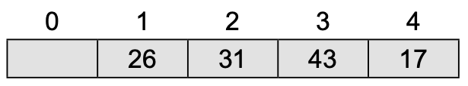
collision
Rehashing: example
Consider the hash table of size 5 with hash function h(x) = x % 5.
Now, we rehash the key from the old hash table into new hash table of size 10 using hash function h(x) = x % 10.

Slide 25
collision
Chaining
In chaining, we store each string in a chain (linked list).
So, if there is collision, we only need to iterate on that chain.

Slide 26
References
S. Sridhar. 2015. Design and Analysis of Algorithms. Oxford University Press. New Delhi. ISBN: 9780198093695. Chapter 5
Reema Thareja. 2014. Data structures using C. Oxford University Press. New Delhi. ISBN:9780198099307. Chapter 15
Thomas H. Cormen, Charles E. Leiserson, Ronald L. Rivest, & Clifford Stein. (2022). Introduction to Algorithms. 04. The MIT Press. London. ISBN: 9780262046305. Chapter 11.
Hash Table, https://visualgo.net/en/hashtable?slide=1
Hash Table, https://leetcode.com/explore/learn/card/hash-table/

